Slide 1
Astro-sage Call Center Performance Analysis
Mohit Kumar
15-03-2026

Slide 2

Problem Statement
AstroSage has received a ₹1 crore investment to improve its call center operations. The goal is to analyse historical call data, performance metrics, and market trends to determine how best to allocate this investment. The objective is to enhance operational efficiency, customer satisfaction, and profitability through data driven decisions on staffing, technology, training, and process improvements.

Slide 3

Objective
The objective of this project is to analyze historical consultation data to identify operational bottlenecks, performance gaps, and customer experience issues, and to provide data-driven recommendations to improve efficiency, satisfaction, and profitability.

Slide 4

Dataset Overview
Dataset contains 28,027 consultation interaction records
Includes calls, chats, ratings, revenue, and agents
Covers platform usage and time-based activity
Provides performance and service quality indicators
Enables detailed operational trend analysis

Slide 5
Methodology
Raw Data
Data cleaned and validated for analysis accuracy
Time fields extracted for hourly and daily trends
Pivot tables used to summarize key metrics
Charts created to visualize patterns and comparisons
Dashboard built for interactive performance monitoring
Cleaning
Analysis
Visualization
Insights

Slide 6
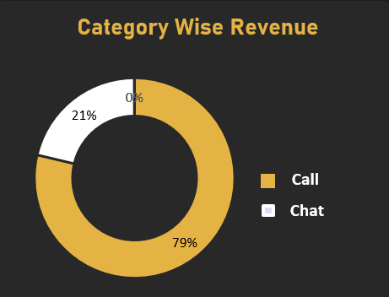
Revenue by Consultation Type
• Call services generate majority of total revenue share
• Calls contribute approximately 79% of earnings
• Chat consultations produce smaller revenue portion
• Revenue distribution depends strongly on call demand
• Call optimization directly impacts profitability

Slide 7
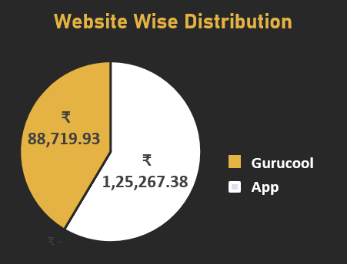
Revenue Distribution by Platform
• App platform generates highest revenue contribution
• GuruCool platform shows lower engagement levels
• Platform usage varies significantly across users
• Revenue imbalance indicates performance differences
• Improving weaker platforms can increase growth

Slide 8
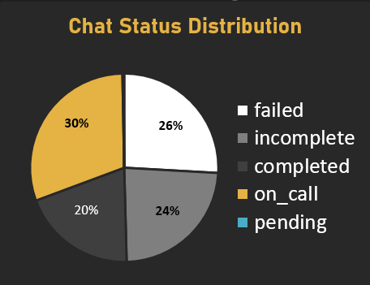
Chat Status Distribution
• On-call chats represent largest share of interactions
• Failed and incomplete chats form significant portion
• Completed chats are comparatively fewer
• Service interruptions affect customer experience
• Reliability improvement required in chat handling

Slide 9
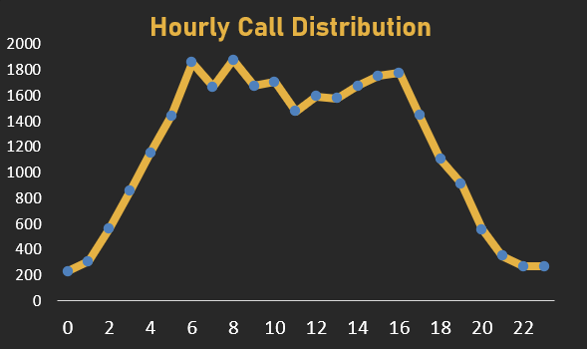
Hourly Call Distribution
• Call volume rises steadily from early morning
• Peak demand occurs during daytime hours
• Traffic remains high from morning through afternoon
• Evening and night show reduced activity levels
• Peak concentration requires staffing optimization

Slide 10
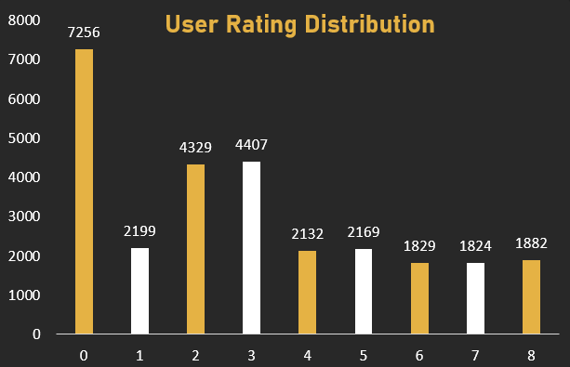
User Rating Distribution
• Majority of users provided low satisfaction ratings
• Rating score zero recorded highest frequency
• Mid-range ratings appear moderately frequent
• Overall average rating measured at 2.93
• Service quality improvement is strongly needed

Slide 11
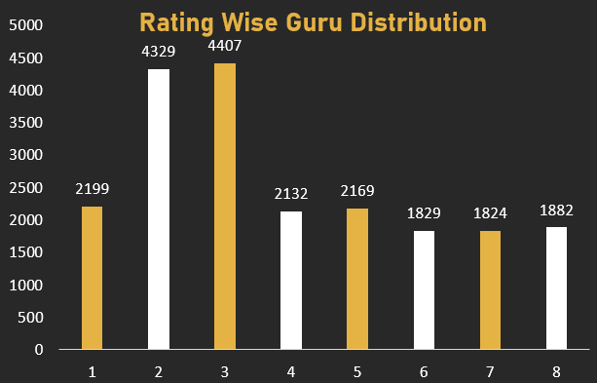
Rating-wise Guru Performance
• Most ratings fall between score ranges two and three
• Very few agents receive high satisfaction scores
• Performance levels vary significantly across agents
• Ratings suggest inconsistent service experience
• Training programs can improve overall performance

Slide 12
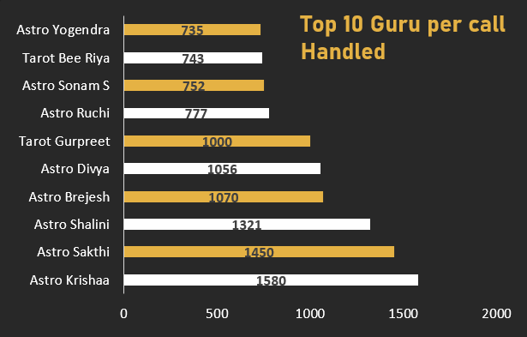
Top Gurus by Calls Handled
• Small group of agents handles most consultations
• Top performers manage significantly higher workloads
• Remaining agents handle comparatively fewer calls
• Workload distribution is highly uneven
• Balanced allocation can improve efficiency

Slide 13
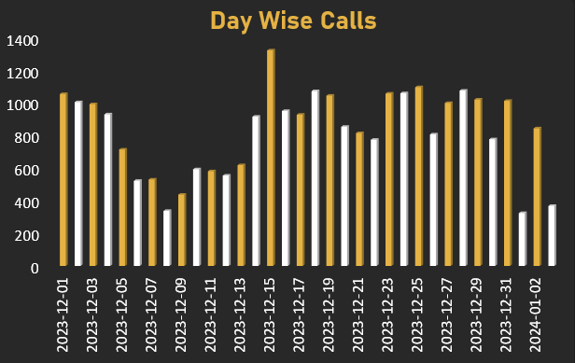
Day-wise Call Volume Trend
• Daily call volumes fluctuate across different dates
• Certain days show sharp demand spikes
• Some days record noticeably low activity
• Usage pattern is not evenly distributed
• Demand forecasting can improve planning

Slide 14
Data-Driven Strategic Recommendations
1.Optimize Peak-Hour Staffing: Hourly analysis shows demand spikes between morning and afternoon → deploy more agents during these hours.
2.Balance Agent Workload: Top agents handle extremely high call volumes while others handle very few → implement intelligent call distribution.
3.Improve Service Quality: Average rating is 2.93 with many low ratings → introduce targeted training and performance monitoring.
Implement Demand Forecasting System: Day-wise and hourly trends show fluctuating call volume → use historical data to predict demand and prepare staffing in advance.
Enhance Platform Performance: Revenue and usage vary by platform → improve lower-performing platforms to balance engagement.
Increase Completion Rate: Presence of failed and incomplete interactions → upgrade routing systems and infrastructure.

Slide 15
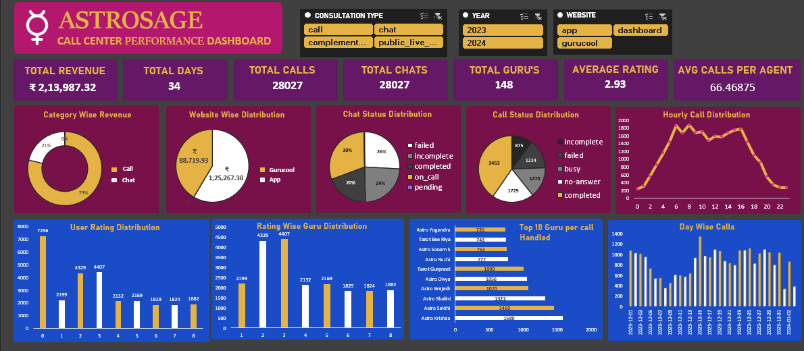
Performance Dashboard

Slide 16

Conclusion
Analysis revealed key operational challenges such as peak-hour overload and uneven agent workload.
Analysis revealed key operational challenges such as peak-hour overload and uneven agent workload.
Customer rating patterns indicate scope for service quality improvement.
Data-driven insights enabled identification of performance gaps and improvement areas.
Strategic recommendations were developed to enhance efficiency, satisfaction, and profitability.

Slide 17

Thank you

